Slide 1









Team 3| Spring’24
HEALTHCARE RECORDS MANAGEMENT
PRESENTED BY-
Manthan Bhatia Reshma Naidu Sambangi Shiva Ranjani Jayanna
Vinay K Vineet Kumar Sehrawat

Slide 2

OVERVIEW
Developing a state-of-the-art U.S. healthcare management database for streamlined patient data handling across medical providers.
Aiming to improve healthcare delivery with efficient, HIPAA-compliant data management and user-centric design.
Integrating seamlessly with current systems, featuring advanced analytics and customizable reporting for superior clinical decisions.
Promising to revolutionize healthcare information management, enhancing operational efficiency and patient outcomes.

Slide 3
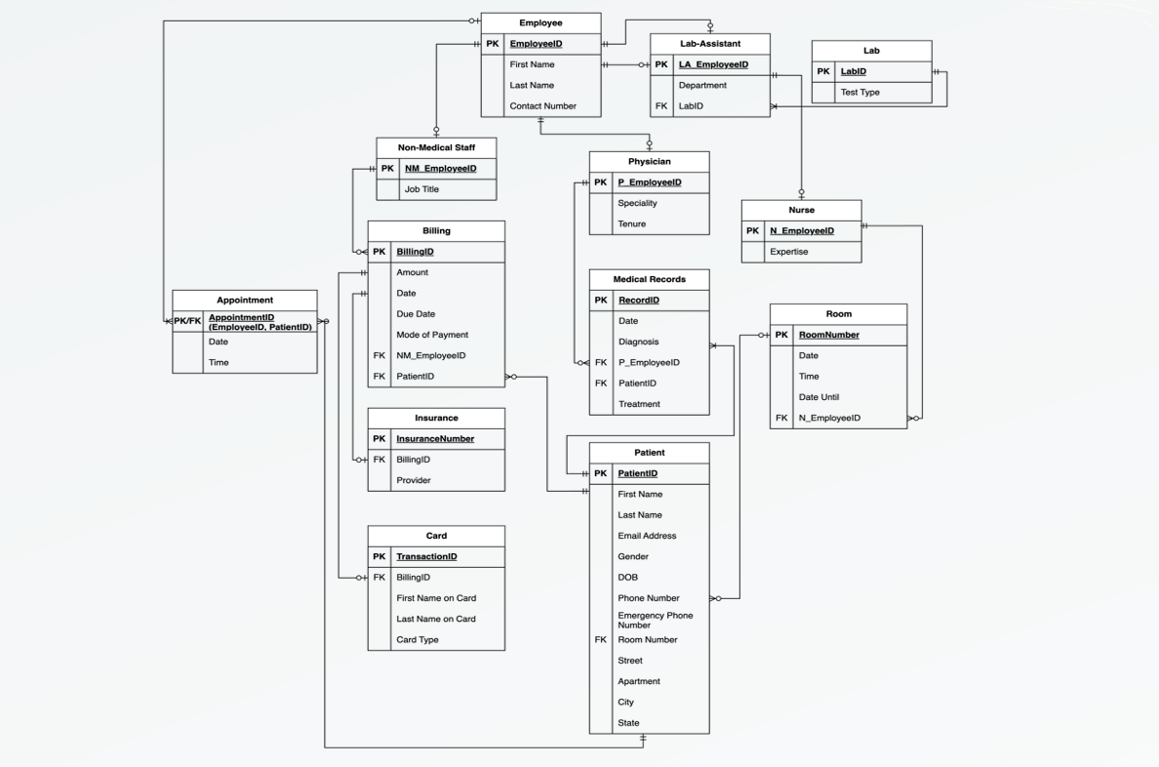
FINAL E-R DIAGRAM

Slide 4
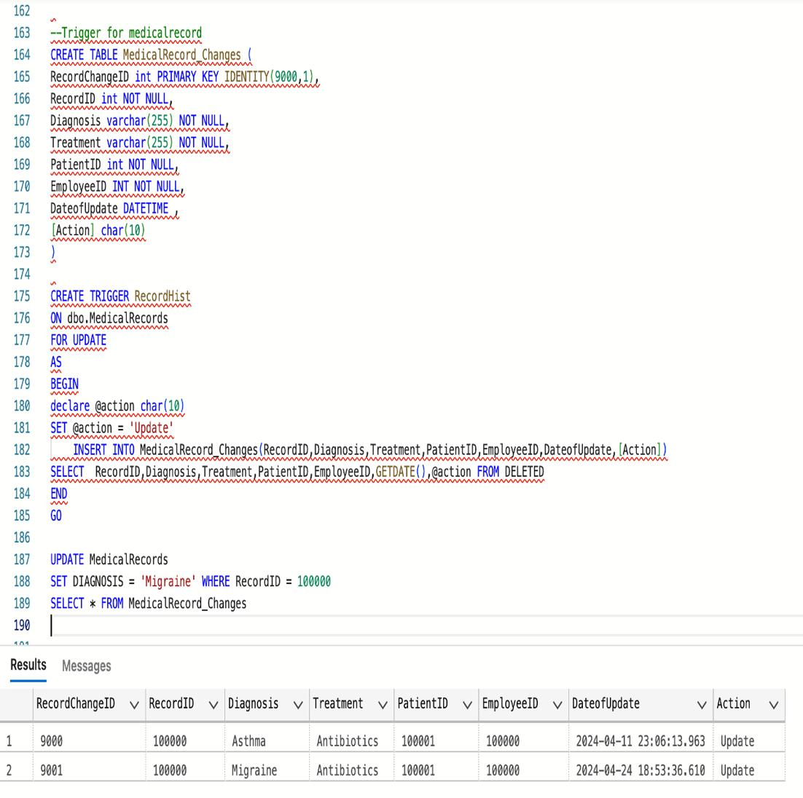
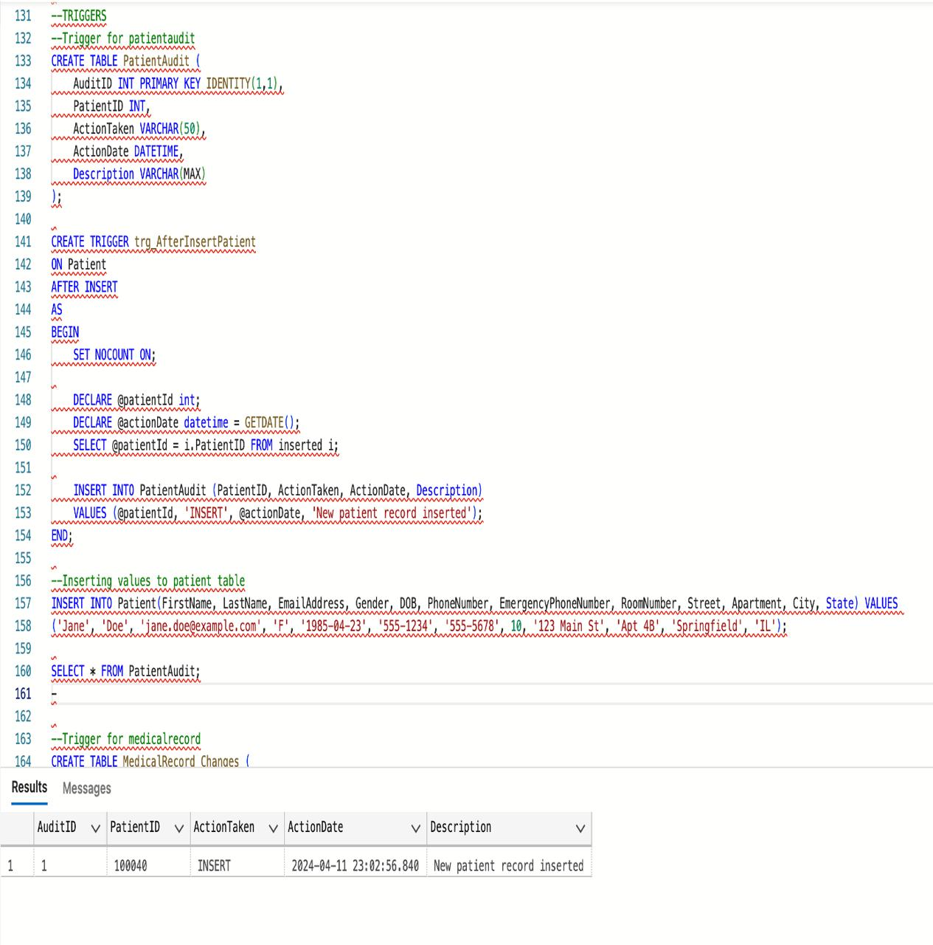
TRIGGERS

Slide 5
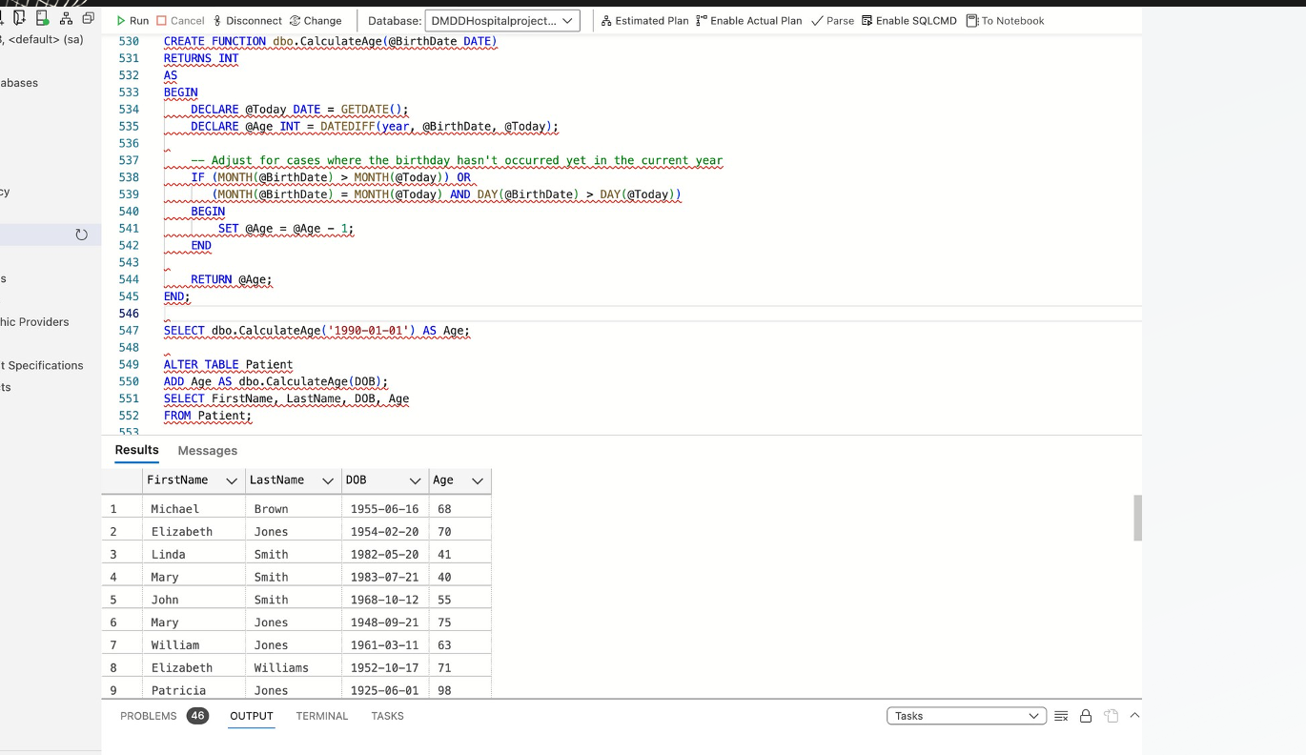
FUNCTIONS

Slide 6
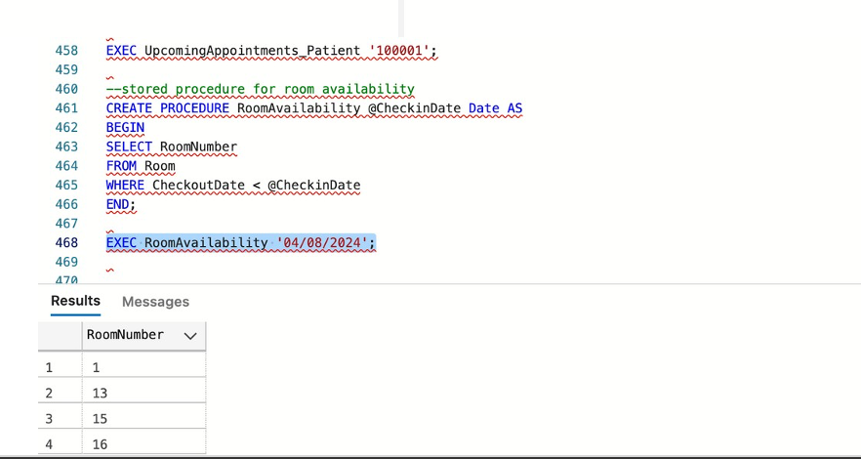
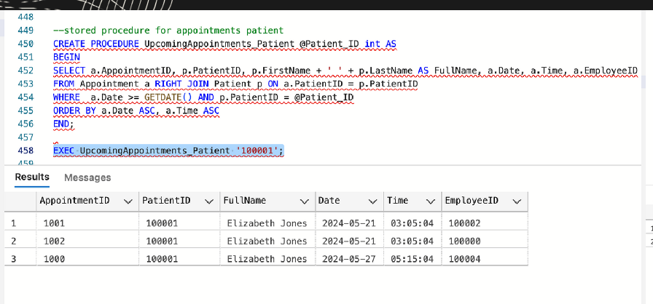
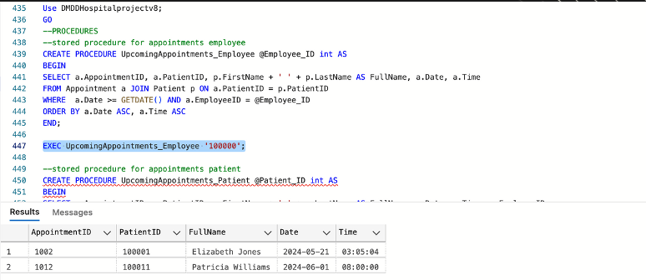
PROCEDURES

Slide 8
PROCEDURES

Slide 10
PROCEDURES

Slide 12
PROCEDURES

Slide 13
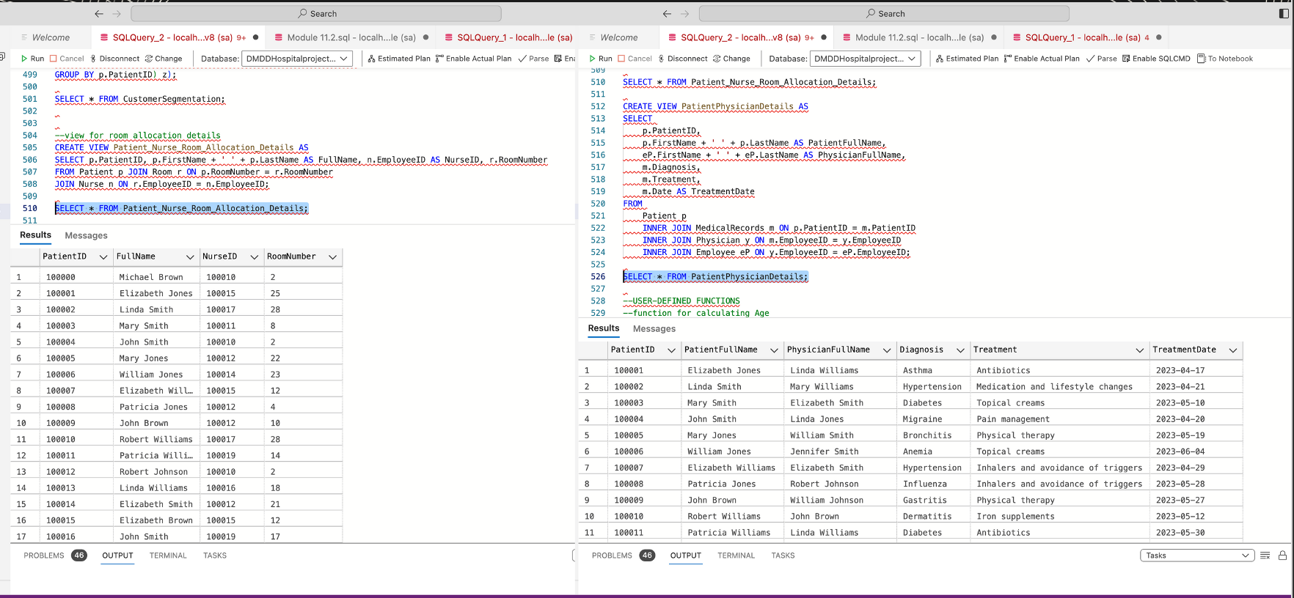
VIEWS

Slide 14
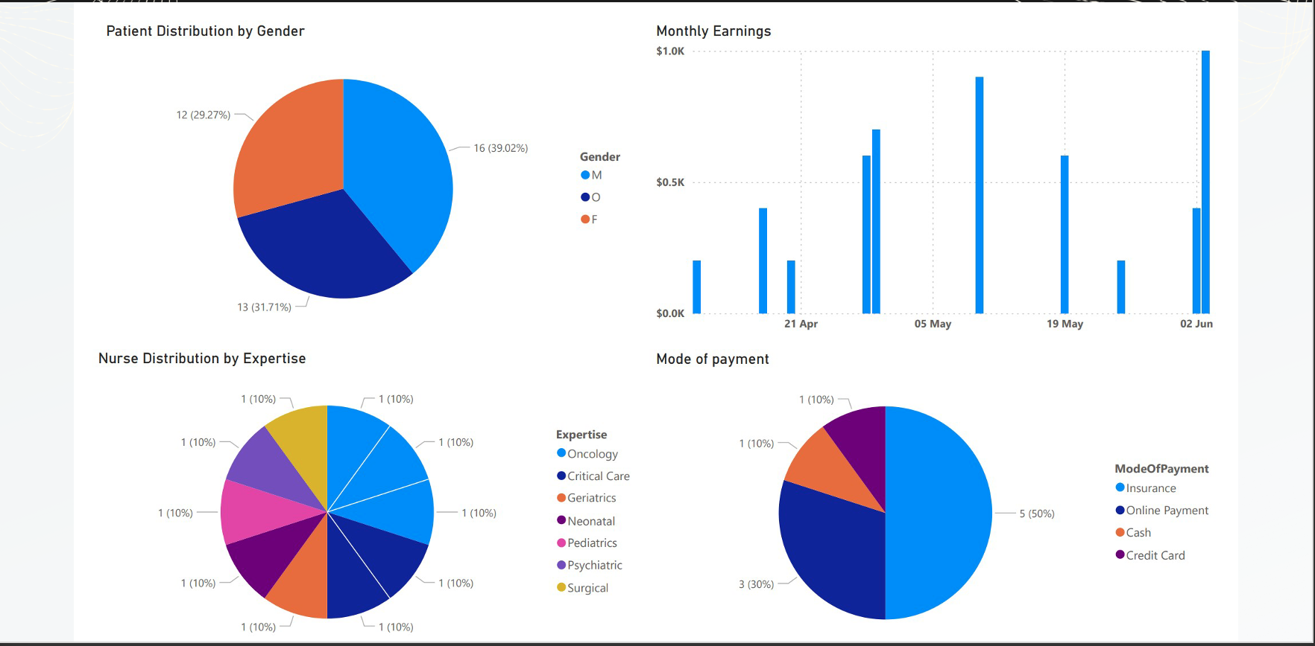
VISUALIZATION

Slide 15


